Slide 1

Areni
Bridging the education gap
for resettled refugees.
أرني

Slide 2
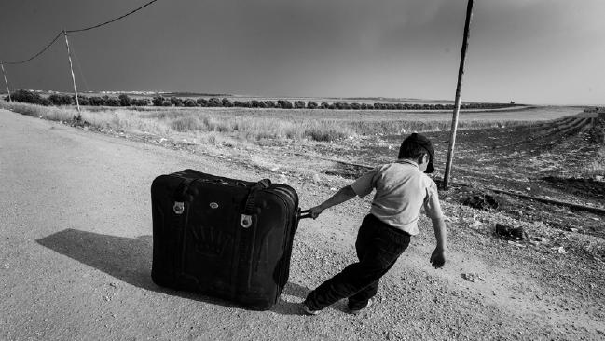

3.7M refugee children not in school
4 years spent out of school
The Problem(s)
1/100 attend university

Slide 3



The problems
Gaps in education
Cultural disconnect
Lack of local resources

Slide 4




Areni accelerates learning and integration for resettled youth refugees by facilitating in-person meetings with local tutors.
Notes:
Not just technology for the sake of technology — technology centered around people and helping newly settled refugee children and their families build real connections with community members.
Distinguishing factor: real, in-person connection.

Slide 5



Students:
Instructors:
Find a tutor by subject, location and language
Schedule free tutoring sessions
Chat within the app
View tutor ratings
Create a profile including subjects, language
Organize tutoring sessions at their own convenience
Chat within the app
Log volunteer hours
★★★★☆

Slide 6
Demonstration

Slide 7

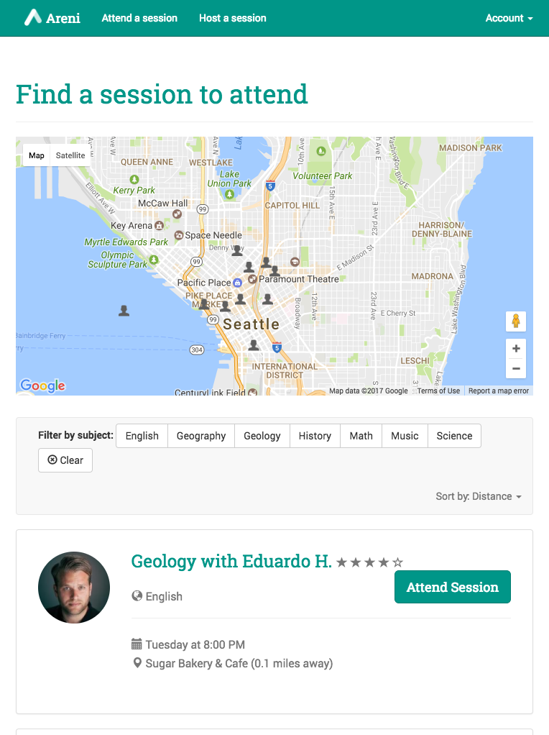
Technology stack
Google Maps API
AngularJS
FireBase
Bootstrap
Responsive
Design

Slide 8
Sustainability
Users
Refugee children
Parents
Providers
University students
Retired teachers
Partners
Cafés, libraries
Schools, non-profits
Areni
Notes:
We already have a partner cafe scratch deli in seattle which could provide free coffe for refugee
Universities will help advertise ou plateform in the univesities

Slide 9
Roadmap
City-by-city expansion, starting with Seattle (top 10 refugee population in the United States)
Prove the model, then grow
Target communities with large refugee populations
Work with local host organizations and schools
Notes:
Top-10 city

Slide 10
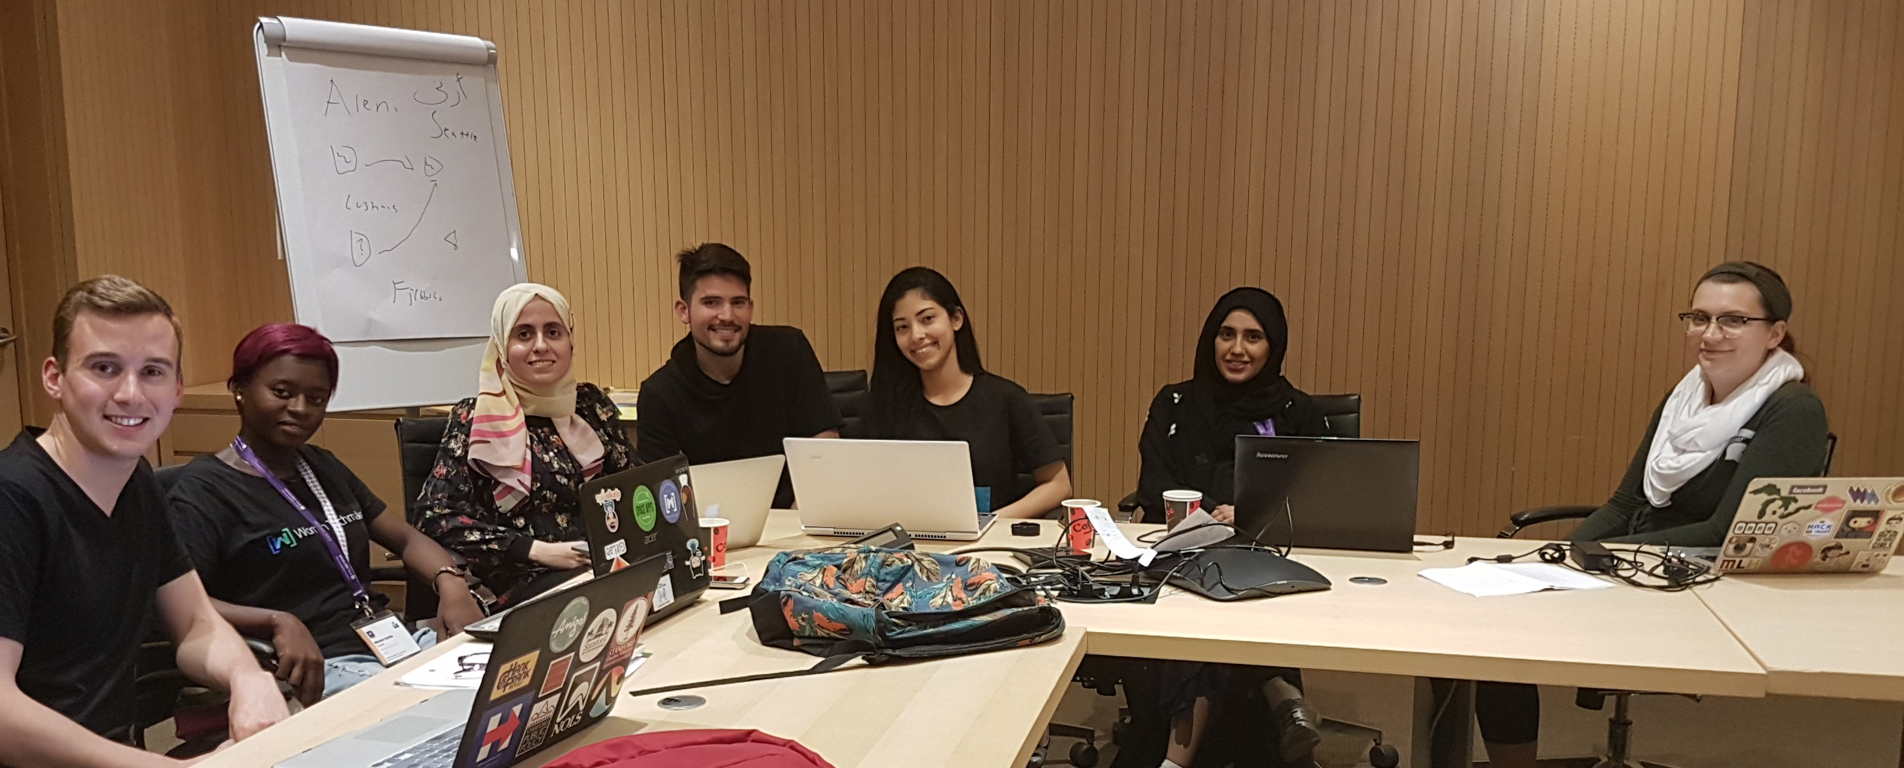
Thank you!
Areni
Students:
Mariam Garba (University Of Ilorin, Nigeria) jumokemariam@gmail.com
Zach Sorenson (Stanford University, USA) zws@stanford.edu
Shaikha Aldoukhi (Khalifa University, UAE) shaikhaaldoukhi@gmail.com
Sana Khiari (INSAT, Tunisia) Sana.khiarii@gmail.com
Mentors:
Samr Samir Ali (Teaching and Research Assistant, Abu Dhabi University, UAE) cen.ssali@gmail.com
Erin Hoffman (PhD, University of Washington, USA) erinrhof@uw.edu
Mike Clarke (Director, HiL, Lebanon) mclarke.reds@gmail.com

Slide 11
Areni

